Slide 1

Backplane Bus Standards (Part 2)
VME Bus Arbitration
  Signals and Protocol
  Arbitration Policies
  Bus Interrupt Structure and Operation
  Evolution : VME64, VME64x, VME320, VXI Bus
Other Backplane Buses:
  PCi,
  Compact Pci,
  PC104, PC104+
©Paul Davies. Not to be copied, used, or revised without explicit written permission from the copyright owner.
This lecture may contain animations and is best viewed as a slide show

Slide 2
VME Bus: The Processor Arbitration Bus
Before a CPU (i.e. a potential Bus master) can communicate across the Data Bus with a board in another slot, it must first gain control of the bus, i.e. it must first become the current bus master.
These rquests are transparent to the CPU. As far as it is concerned, it outputs an address etc and waits for the Dtack that would indicate that is has taken control of the bus (i.e. become the current master) and that data has been transferred. This is all handled internally by chip sets that interface the CPU to the VME bus.
This requirement stems from the fact that VME is a high performance bus with the ability to support multiple CPUs in multiple slots all executing in parallel and using shared memory and/or shared peripherals for communication. (Each processor card probably has its own local memory and IO to cut down on Bus traffic)
Arbitration is conducted by a Bus Arbiter Module (BAM) or System Controller which must physically reside in Slot 1 of the VME backplane. (The reason for this will become clear later.)
The task of the arbiter is to allocate the bus to whichever of the requesting Bus Masters is deemed to have the highest priority at the time.
Several arbitration policies exist for determining what is the highest priority Bus Master.

Slide 3
VME Bus: The Processor Arbitration Bus
The arbitration bus comprises 14 signals as shown opposite.
BR0-BR3 are 4 open collector/drain bus request lines that can be pulled low by any potential bus master to request control of the bus.
Bus requests BR0*-BR3* travel the full length of the backplane into the arbitration module located in slot 1.
Potential Bus masters (CPU boards) can request the bus on one of these 4 different request levels, or several can share a common bus request signal with other bus masters.
In response to a bus request, the arbiter prioritises all bus requests (if there is more than one) and drives the BGxOUT signal corresponding to the bus master now being given control of the bus.
Pin | Signal | Name | Function
12b 13b 14b 15b 5b 7b 9b 11b 1b 2b 4b 6b 8b 10b | BR0* BR1* BR2* BR3* BG0OUT* BG1OUT* BG2OUT* BG3OUT* BBSY* BCLR* BG0IN* BG1IN* BG2IN* BG3IN* | Bus Request 0 Bus Request 1 Bus Request 2 Bus Request 3 Bus Grant Out 0 Bus Grant Out 1 Bus Grant Out 2 Bus Grant Out 3 Bus Busy Bus Clear Bus Grant In 0 Bus Grant In 1 Bus Grant In 2 Bus Grant In 3 | Used by a Bus requester to attempt to gain control of the Data Bus. Generated initially by the arbiter which propagates to BGxIN* in Slot 2. The module passes it on if not requesting bus. Indicates Bus is Busy. A request from Arbiter to clear the bus. Used by modules to indicate that they are being given the bus.
BBSY* indicates that the bus is busy.
BCLR* is a request issued by the arbiter for the current bus master to relinquish control of the bus, however this is only a request and it cannot be forced to comply within any specified time period.

Slide 4
Arbiter responds by issuing BG0OUT* which is received by CPU in Slot A2 as BG0IN*
CPU in Slot A2 is not requesting the bus on BR0*, so it propagates BG0IN* to BG0OUT* until it reaches 1ST CPU THAT IS asserting BR0* i.e. CPU in slot A3
Slot A1
Slot A2
Slot A3
Slot A4
BG0IN*
BG0OUT*
BG1IN*
BG1OUT*
BG2IN*
BG2OUT*
BG3IN*
BG3OUT*
NOTE: Links connecting BGxIN* to BGxOUT* are broken if a slot is empty - Jumpers then have to be placed on underside of backplane.
BR0*
BR1*
BR2*
BR3*
BBSY*
BCLR*
Bus Master negates BBSY* and BR0*.
Bus now idle
Arbiter Slot
CPU
CPU
CPU
Simple Bus Request/
Bus Grant Protocol
CPU in slot A3 asserts BR0* which travels to the arbiter in slot A1
New Bus Master Asserts BBSY*

Slide 5
VME Bus: The Processor Arbitration Bus
Bus Arbitration Policies
Because VME bus supports Multiple Bus Masters (e.g. CPU cards) there has to be a protocol for a CPU board to request the bus and be given control of it, if several bus masters issue bus requests simultaneously.
VME bus defines three different arbitration schemes or policies for determining which level of bus request is deemed to have the highest priority at the time. The scheme is then used to decide which bus master will be granted the bus in the event of two or more simultaneous requests. These three schemes are referred to as.
  Single Level Selection (SGL)
  Fixed Priority Selection (PRI)
  Round Robin (Rotating Priority) Selection (RRS)

Slide 6
Arbiter responds by issuing BG3OUT* which is received by CPU in Slot A2 as BG3IN*
CPU in Slot A2 is NOT requesting the bus on BR3*, so it propagates BG3IN* to BG3OUT* until it reaches CPU in slot A3 which does NOT pass it on, so CPU in slot A3 becomes current bus master
CPU in Slot A3 is NOT requesting the bus on BR3*, so it propagates BG3IN* to BG3OUT* until it reaches CPU in slot A4 which becomes bus master
Slot A1
Slot A2
Slot A3
Slot A4
BG0IN*
BG0OUT*
BG1IN*
BG1OUT*
BG2IN*
BG2OUT*
BG3IN*
BG3OUT*
Single Level Arbitration (BR3* Only)
CPU closest to Arbiter has highest priority for each BRx*
BR0*
BR1*
BR2*
BR3*
BBSY*
BCLR*
Bus Master Releases Bus by negating BBSY* and it’s BR3*
Arbiter Slot
CPU
CPU
CPU
CPU in slot A3 and A4 BOTH assert BR3* simultaneously which travels to the arbiter in slot A1
New Bus Master Asserts BBSY*

Slide 7
Arbiter now gives Bus to CPU in slot A3 as it is requesting on BR0*
Arbiter Prioritises and gives Bus to CPU in slot A4 as it is requesting on the highest priority BR3*
Fixed Priority Arbitration: BR0–3
Unfair, may Lead to Starvation
Slot A1
Slot A2
Slot A3
Slot A4
BG0IN*
BG0OUT*
BG1IN*
BG1OUT*
BG2IN*
BG2OUT*
BG3IN*
BG3OUT*
BR0*
BR1*
BR2*
BR3*
BBSY*
BCLR*
Lowest priority BR0
Highest priority BR3
Arbiter Slot
CPU
CPU
CPU
Simultaneous Bus Request on BR0* from Slot A3 and on BR3* from Slot A4
New Bus Master Asserts BBSY*

Slide 8
Arbiter Prioritises and gives Bus to CPU requesting on the current highest priority
Rotating Priority Arbitration: BR0-3
Avoids Starvation
Slot A1
Slot A2
Slot A3
Slot A4
BG0IN*
BG0OUT*
BG1IN*
BG1OUT*
BG2IN*
BG2OUT*
BG3IN*
BG3OUT*
Arbiter Priority
Lowest priority
BR0*
BR1*
BR2*
BR3*
BBSY*
BCLR*
BR0
BR1
BR2
BR3
Highest priority
Arbiter Slot
CPU
CPU
CPU
Simultaneous Bus Request from
Slot A3 and Slot A4
New Bus Master Asserts BBSY*

Slide 9
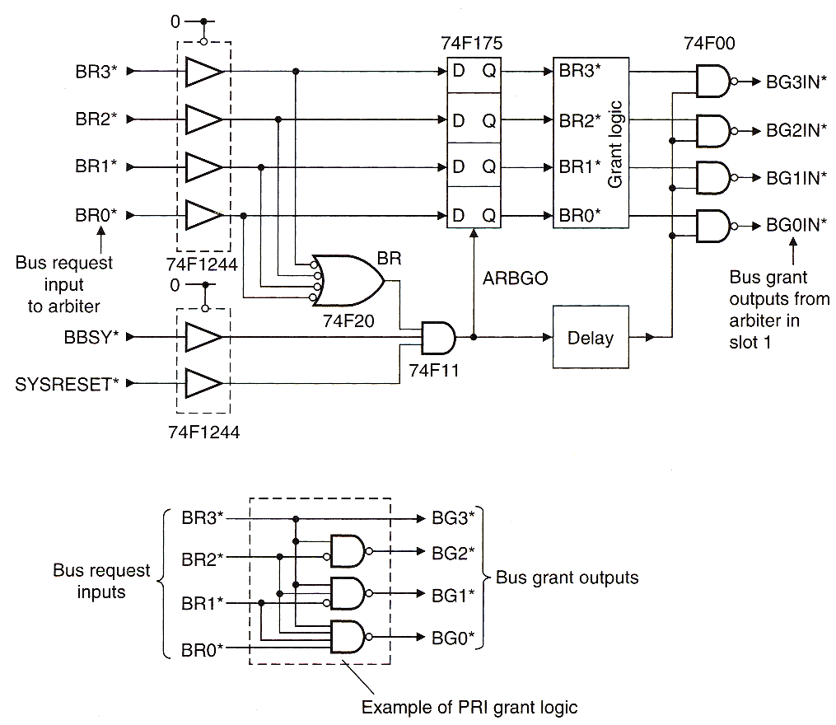
Simple Fixed Priority Arbiter Design
0
1
BR3*
BG3
1
0
Level 3 highest Priority
BR2*
BG2
0
0
BG1
BR1*
0
1
BG0
BR0*
Bus Request On Level 3 and 1
Example Prioritising Logic (active low-in, high-out)
0
0
1
Bus Request Inputs to Arbiter from Potential Bus Masters
BR3*
BG3OUT*
0
1
1
0
BR2*
BG2OUT*
1
Bus Request 3 output placed onto backplane
0
0
0
BR1*
1
1
0
BG1OUT*
1
BR0*
BG0OUT*
1
CLK
Bus Request Outputs enabled after short delay to avoid metastability problems at the latch
1
BBSY*
1
SYSRESET*
This signal asserted when the bus is not reset, not busy and an active low Bus Request occurs on any level, causing simultaneous latching of all BRx* signals by the D-Type Latch

Slide 10
VME Bus – The Interrupt Architecture
The structure of the interrupt bus on VME closely mirrors that of the 68000, providing 7 prioritized, vector capable, interrupt requests levels.
The 10 signals associated with the VME interrupt bus are shown in the attached table.
IRQ1* - IR7* are 7 interrupt requests that can be pulled low by any interrupt capable peripheral located on any module in the backplane.
IACK* is a signal issued by an interrupt handler (typically a CPU module) to indicate that it is acknowledging receipt of the interrupt and will be dealing with it shortly.
IACKIN* and IACKOUT* form an interrupt acknowledge daisy chain that propagates along the backplane from system controller (arbiter in Slot 1) until it reaches the interrupting device, which could be located in any slot in the backplane.
Pin | Mnemonic | Name
24b 25b 26b 27b 28b 29b 30b 20a 21a 22a | IRQ7* IRQ6* IRQ5* IRQ4* IRQ3* IRQ2* IRQ1* IACK* IACKIN* IACKOUT* | Interrupt Request 7 Interrupt Request 6 Interrupt Request 5 Interrupt Request 4 Interrupt Request 3 Interrupt Request 2 Interrupt Request 1 Interrupt Acknowledge Interrupt Acknowledge In Interrupt Acknowledge Out

Slide 11
CPU Places IRQ level onto A1-A3 and attempts to read Vector #
Interrupter supplies Vector# 25 on Data bus
Arbiter eventually issues BGxOUT* and gives CPU control of the bus
IRQ Received at CPU
VME Bus Signals
Interrupt from Slot 4 on IRQ3*
IRQ Ack Level = 3
A1-A3
CPU issues BRx* to gain control of the bus to acknowledge the interrupt
Vector Number = 25
D0-D7
IRQ3*
Slot 1
Slot 2
Slot 3
Slot 4
CPU Reads Vector Number and jumps to ISR to deal with and clear interrupt
IACK
daisy-chain
driver
Interrupt
Handler
Non-
Requesting
Interrupter
Requesting
Interrupter
Vector #37
Vector #25
IACK* Received by Arbiter as IACKIN*
Arbiter
CPU
Peripheral
Peripheral
IACKOUT*
IACKIN*
IACKOUT*
IACKIN*
IACKOUT*
IACKIN*
Arbiter Re-issues as IACKOUT*
IACKIN*
Interrupter supplies DTACK*
IACK*
AS* , R/W=1
DTACK*
CPU generates IACK
CPU also issues AS* and R/W=1
VME Bus Signals
IACKOUT* propagates to Source

Slide 12
VME Bus – The Interrupt Architecture
Centralised Interrupt Handling
This arrangement is common in single processor systems where all 7 levels of interrupt request must be dealt with by the one processor card
Distributed Interrupt Handling
An alternative arrangement, particularly attractive in multiple CPU systems is to distribute the interrupt handling, so that each processor is designated a sub-set of the interrupt request levels to deal with (see diagram bottom right).
IRQ1
IH (1-7)
IRQ7
IRQ2
IRQ6
IRQ3
IRQ5
IRQ4
IH (3-5)
IH (1-2)
IH (6-7)
IRQ3
IRQ5
IRQ4
IRQ1
IRQ2
IRQ6
IRQ7

Slide 13
VME Bus: Functionality
VME Utilities Bus
The VME Utilities bus comprises of the 6 miscellaneous signal shown in the table below
Pin | Mnemonic | Name
10a 3b 12c 10c 22b 21b | SYSCLK* ACFAIL* SYSRESET* SYSFAIL* SERDAT* SERCLK* | System Clock (16MHz) Power Failure System Reset System Failure Serial Data Bus Serial Clock

Slide 14
The Support and Evolution of VME bus

Slide 15
VME Bus International Trade Association (VITA)
The VME bus specification is maintained by VITA and is an incorporated, non-profit making organization of VME bus vendors and users having a common market interest, i.e. the promotion of the bus and maintaining and evolving standards.
Founded in 1984, VITA believes in and champions open system architectures as opposed to proprietary system architectures.
Visit their web-site at www.vita.com
For a list of members of VITA and members supplying VME products Visit
http://www.vita.com/MemberRoster
For a list of FAQ visit
http://www.vita.com/page-1855175

Slide 16
VME64 – MBLT Protocol
VME64 extended the life of VME bus well into the 21st century, with enhancements such as higher bandwidths, larger address spaces and easier-to-use cards.
VME64 is a mechanical and electrical 'superset' of the original IEEE 1014-1987 VME standard. Some of the new features it offers are listed below:
  Increase in data and address bus width from 32 bits to 64 bits by multiplexing 64 bit data and address signals onto the 32 bit data/address lines of the original VME bus.
  This addition introduced a new protocol along the backplane which was given the name MBLT (or multiplexed block transfer) which doubled the bandwidth of VME bus to 80 Mbytes/sec, but could only be used with VME64 compatible CPUs and peripheral boards, thus the memory map/IO space of the system could be partitioned into areas that supported the protocol and those that could not, i.e. used the original VME protocol.
  The address modifier pins AM0-AM5 (driven/tagged with every bus cycle) were used to indicate whenever this new signalling protocol was in use, thus boards that understood the protocol could work with it, while those that did not, ignored it.
  Lower electrical noise connector added.
  New Bus LOCK cycles, to improve performance in multi-processor systems by allowing a CPU to transfer blocks of data without relinquishing the bus to another CPU after each bus cycle (64 bit transfer).

Slide 17
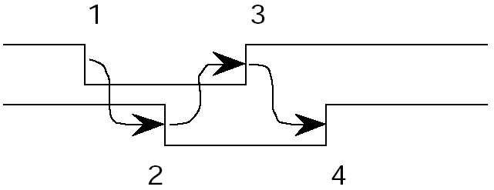
VME64
VME64 also used 4 strobe edges to perform a single data transfer of 64 bits of data as shown below giving 80Mbytes per second bandwidth.
This simple asynchronous transfer suffered in that it required signals to travel 4 times up/down the length of backplane in order to complete one bus cycle or 64 bit transfer.
1) Data Strobe asserted by master travels up backplane to slave to let it know data is being transferred
3) Master sees Slave acknowledge receipt of data and removes data strobe
CPU Data Strobe
Memory DTACK
4) Slave sees master has removed data strobe and thus removes acknowledge
2) Slave asserts an acknowledge back down backplane to master indicating it has received/transmitted data
Data
32/64 bits

Slide 18
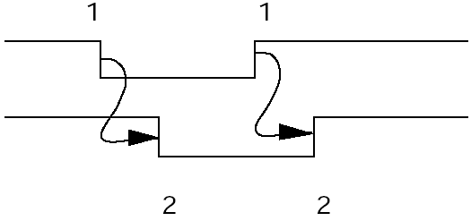
VME64x – 2eVME Protocol
In 1997, VITA adopted a superset to the VME64 standard called the VME64 Extensions or VME64x, which doubled the speed of data transfer to 160Mbytes per second using a new protocol called 2eVME or twin edged VME.
This allowed data to be transferred on both edges of a CPU data strobe thus reducing the number of signal traversals along the backplane to 2 doubling speed.
This new protocol was again supported by new address modifier codes on AM0-AM5.
Data transferred on the falling edge of data Strobe
Data also transferred on the rising edge of data Strobe
CPU Data Strobe
2x improvement in data rate
Memory DTACK
Slave acknowledges data received/transmitted
Slave acknowledges data received/transmitted
Data
64bits
64bits

Slide 19
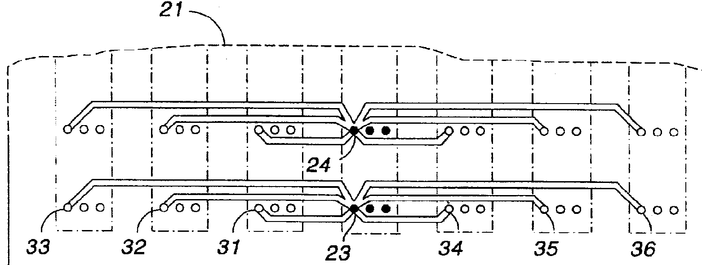
VME320
In 1997 a modified VMEbus architecture (VME320) was released by Arizona Digital Inc.
Operating at over 320 Mbyte/second over the full 21 slots
Performance achieved through the use of an innovative new backplane design which its inventors claim patent protection within the USA. Use is license free.
A VME320 backplane uses a 'star' interconnection method to speed up signal propagation times. Here all signals on the backplane are connected together at the middle slot (e.g. Slot 11) of the backplane.
A signal travelling from slot 1 to slot 2 goes from slot 1 to slot 11 and then back to slot 2. This dramatically alters the electrical characteristics of the bus allowing it to be treated as a lumped capacitance (with just rise and fall times) as opposed to a transmission line with reflections, thus allowing signals to propagate faster
The numbers below relate to points in the patent application and are not technical.
Left most slot
Middle slot
Right most slot

Slide 20
VME320 – 2eSST Protocol
The increased complexity of joining every signal “star fashion” means that 10-14 layers of PCB copper are required, increasing the cost, but VME320 backplanes are backward compatible with original VME bus board as only conductor routing has changed.
The VME320 concept introduced a new bus protocol called 2eSST
The protocol is synchronous, (no handshake required from the recipient) reducing the propagation delays associated with transferring data to one length of the backplane.
Speed is only limited by timing skew between source and receiver (i.e. make sure data arrives before the Data Strobe) . If skew is tightly controlled (by the star arrangement), speed improvements can be dramatic.
Projected growth in bandwidth for VME320 and beyond is now estimated to be in excess of 2GBytes/sec along a full 21 slot backplane.
See articles on VME320 and Arizona Digital on Canvas.
VME320 2eSST Protocol – no handshake
Data
1
2
3
4
5
6
7
8
9
10
11
12
Data Strobe
64 bit transfer per data strobe edge

Slide 21
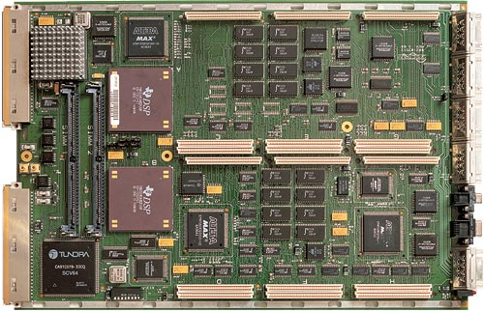
VME Extensions
VXI Bus : VME Bus Extensions for Instrumentation (IEEE – P1155)
VXI bus is another (radical) extension to VME bus to cater for instrumentation, test and measurement and other very high speed applications
It is not really backward compatible with VME.
It permits bigger cards (9U and 12U, i.e. HUGE !!!!)
Visit http://www.vxibus.org/ for an overview.
TMS320C4x VXI-Based Board
Two embedded 60 MHz TMS320C40 DSPs with support for plug in “mezzanine” modules.

Slide 22
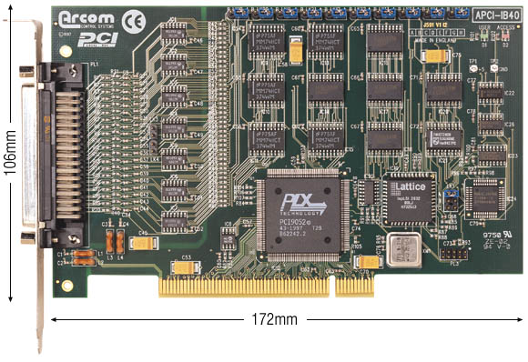
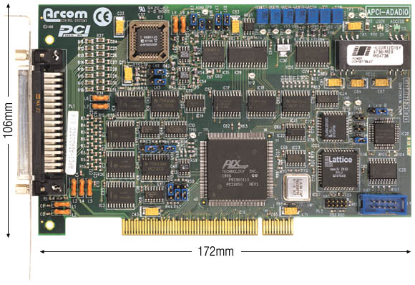
Other Backplane Bus Standards
PCi Bus
Totally non-standard mechanical specification makes it unattractive to industry.
  No support for Multiple CPU’s
  16 Interrupts handled centrally
  Origins in 32 bit Intel 386 CPU.
  Synchronous /burst data transfers running with 33 MHz backplane clock gave initial bandwidth of 133 MB/sec
  Later versions used 66Mhz and eventually 133Mhz backplane clock
  64 bit data bus extension gave 266MB/sec @ 33Mhz and 1GB/sec at 133Mhz
  Gold plated edge connectors unreliable
  Cannot be mounted in 19” rack.
  Motherboard with plug-in vertical daughter board concept make packaging difficult.
  Superseded by PCi-Express, a serial based version of PCi bus.
40 line Digital IO Card on PCi Bus
16 channel 12 bit ADC + 2 channel DAC on PCi bus

Slide 23
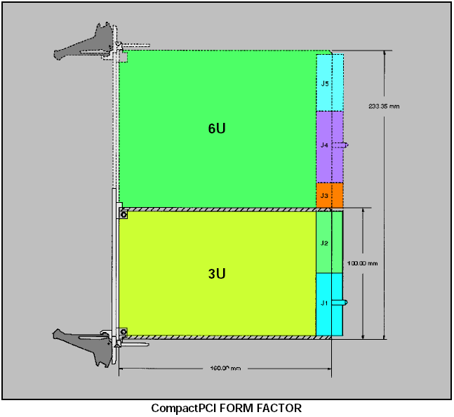
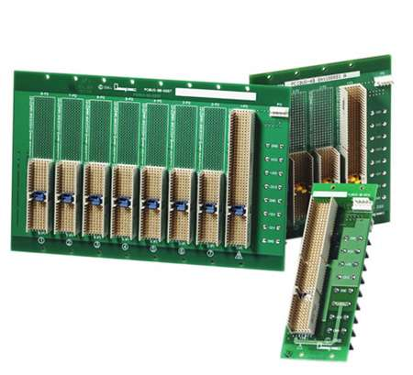
Other Backplane Bus Standards
Compact PCI Bus (cPCI)
Another relatively recent 3U/6U backplane standard aimed at applications requiring a more robust PC type architecture
Uses IEC 1076 - 235 pin connector arranged as 5 rows * 47 pins which is widely used in telecoms.
Connector not as mechanically reliable as DIN41612 connectors but shielded for extra EMI/RFI protection.
J1 carries basic 32 bit data/address signals.
J2 carries additional Data and address signals for 64 bit (an advantage over VME which requires 6U boards to support 64 bit processing).
Up to 3 other connectors can be defined (on 6U boards) allowing for local buses.
Electrical Features
32/64 bit data paths (J1/J2).
8 Slot backplane @ 33/66/133 MHz Clock
Bandwidth: 133 Mbytes/sec to 1 Gbyte/sec

Slide 24
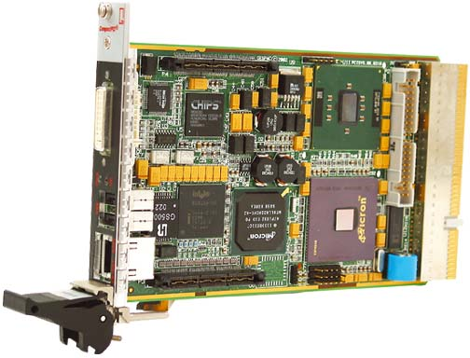
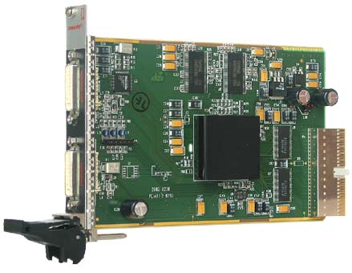
Other Backplane Bus Standards
Some Compact PCi Cards are shown below.
Processor card
Graphics card

Slide 25

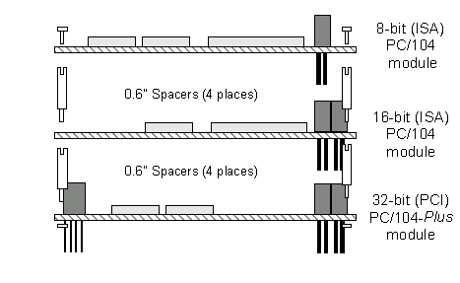
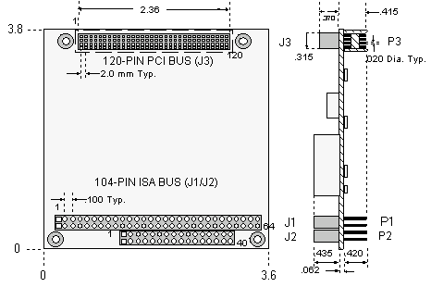
Other Backplane Bus Standards
PC/104 and PC/104+ Buses
Invented in 1987, and standardised as IEEE-P996.1 in 1992, the original PC/104 bus addressed the need for very compact PC architectures for small embedded applications, like robots.
Specification
Compact: 3.6 by 3.8 inches (90 x 96 mm) module size .
Self-stacking: expands without backplanes or card cages. Uses spacers at each corner which are very resistant to shock and vibration.
Pin-and-socket bus connector: “reliable” in harsh environments.
Low power consumption.
Fully PC compatible.
Electrical interfaces
The original PC/104 standard proposed two connectors
  J1 with 64 pins that implement the original PC 8 bit ISA (PC/AT) bus
  Optional J2 with 40 pins with support for 16 bit ISA bus.
PC/104+ Bus
Proposed an additional 120 pin P3 connector with support for the more modern 32 bit PCI bus.
More details
See www.pc104.org, www.pc104.com, www.controlled.com/pc104/

Slide 26
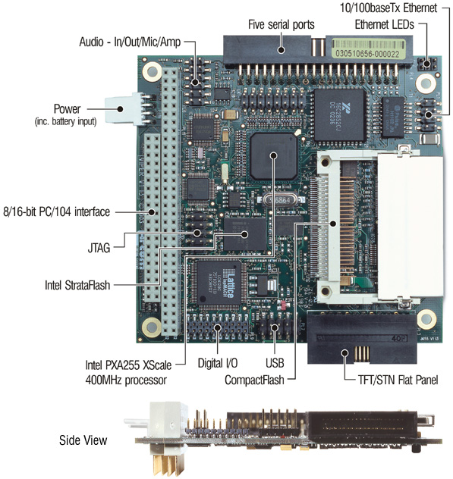
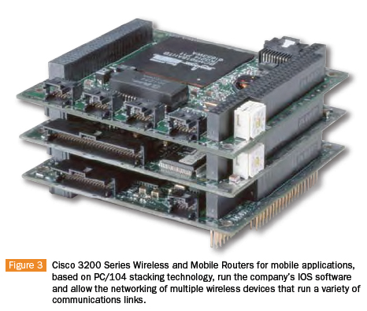
Other Backplane Bus Standards
A PC/104 Processor based on Intel® 400MHz PXA255 XScale® processor (http://www.eurotech.com/en/products/embedded+boards) is shown below left.
The image on the right is a wireless router from CISCO based on PC/104+ bus with the PCi bus connector.
PCi connector J3

